Slide 1
Concepts of Data Sciences

Slide 2
Concepts of Data Science
Data Science is the field that helps in extracting meaningful insights from data using programming skills, domain knowledge, and mathematical and statistical knowledge.
It helps to analyze the raw data and find the hidden patterns.
Data Science is an interdisciplinary field that allows you to extract knowledge from structured or unstructured data.
A person should be clear with statistics concepts, machine learning, and a programming language such as Python or R to be successful in this field

Slide 3
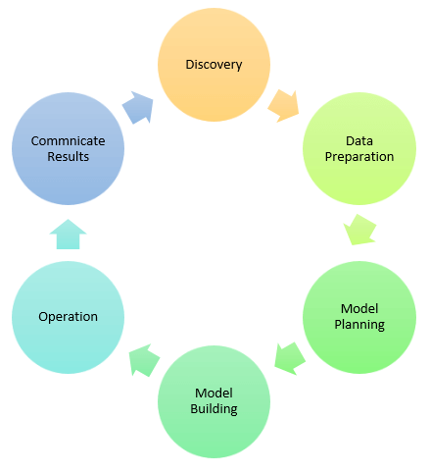

Slide 4
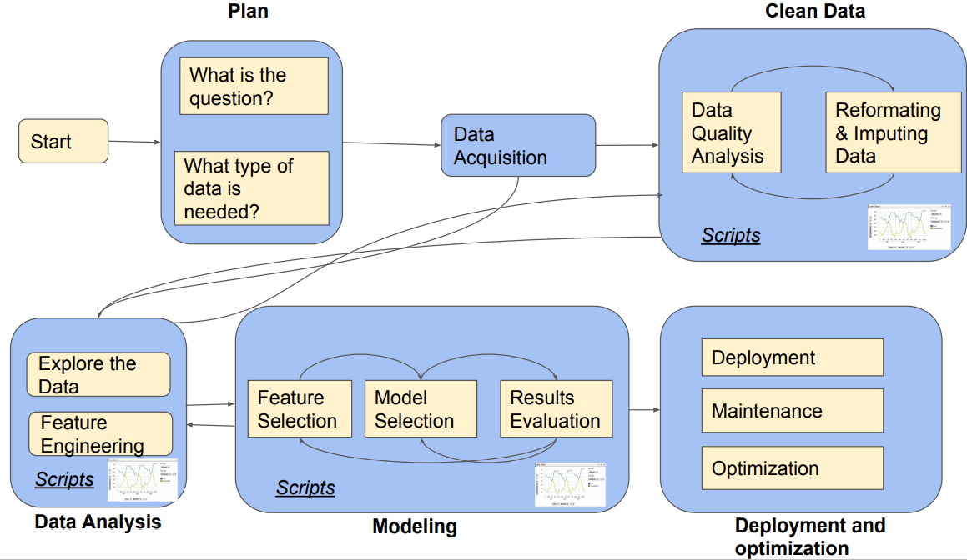

Slide 5
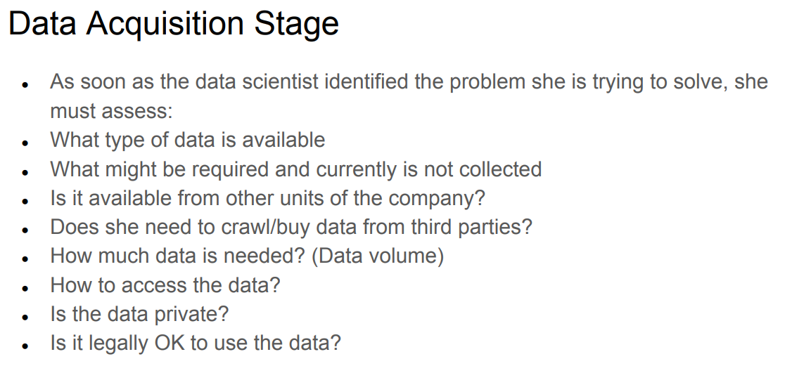

Slide 6
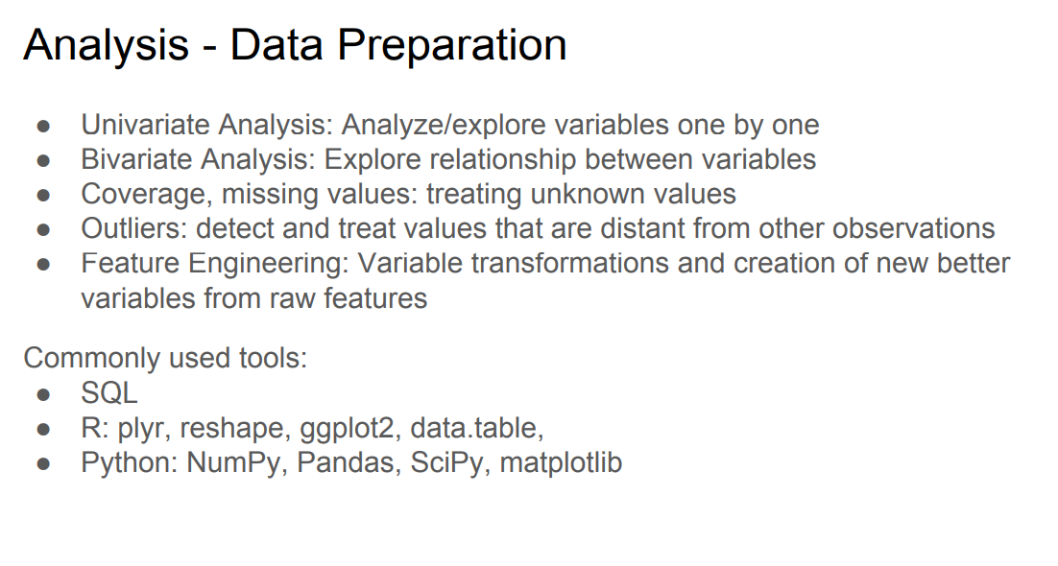

Slide 7
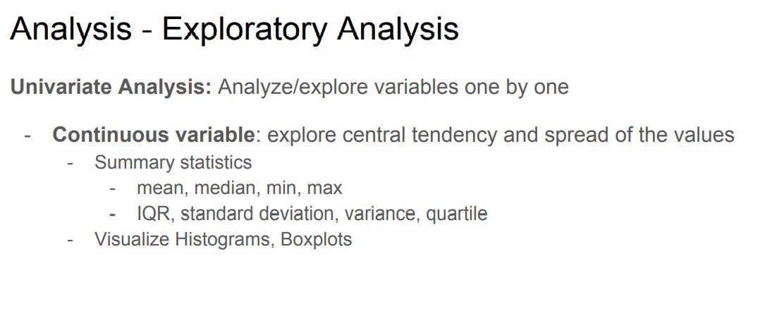

Slide 8
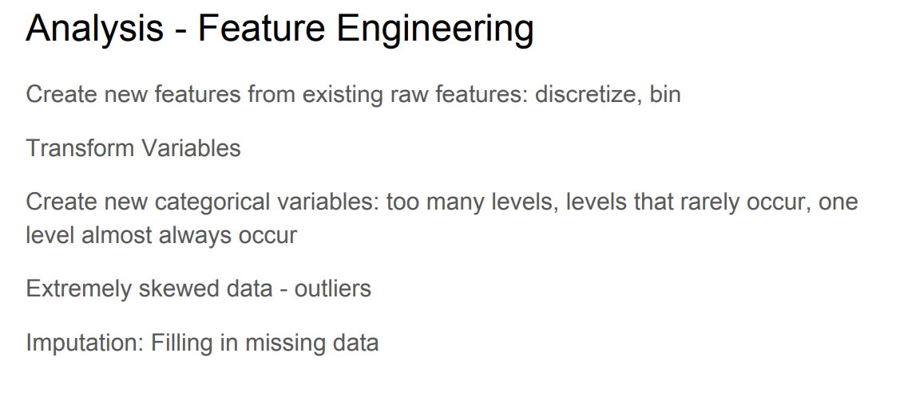

Slide 9
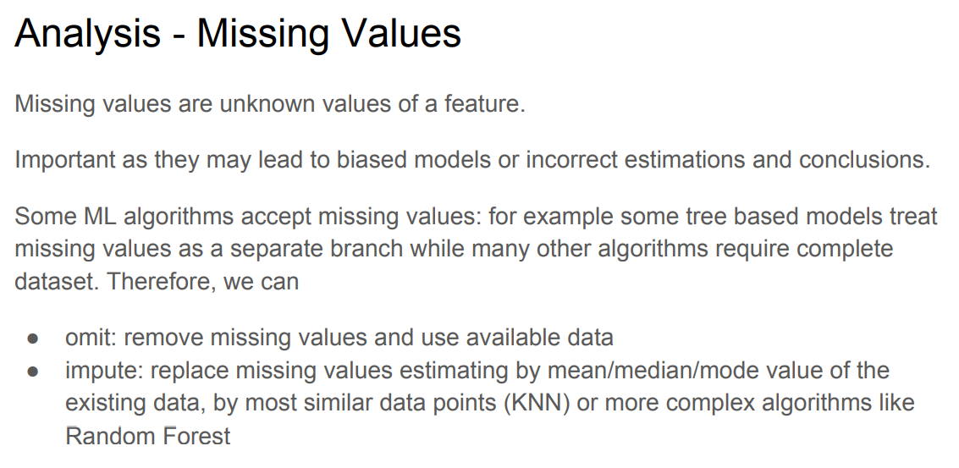

Slide 10
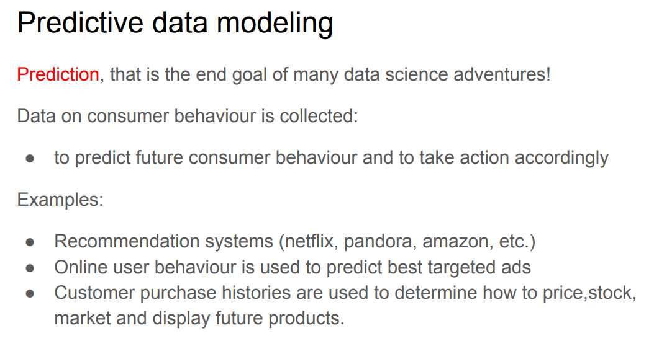

Slide 11
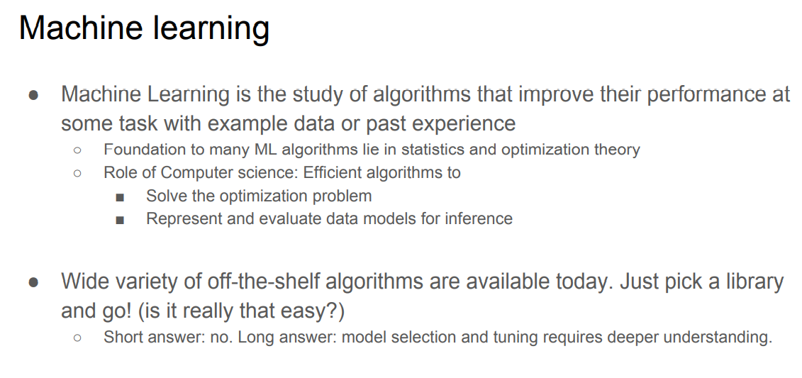

Slide 12
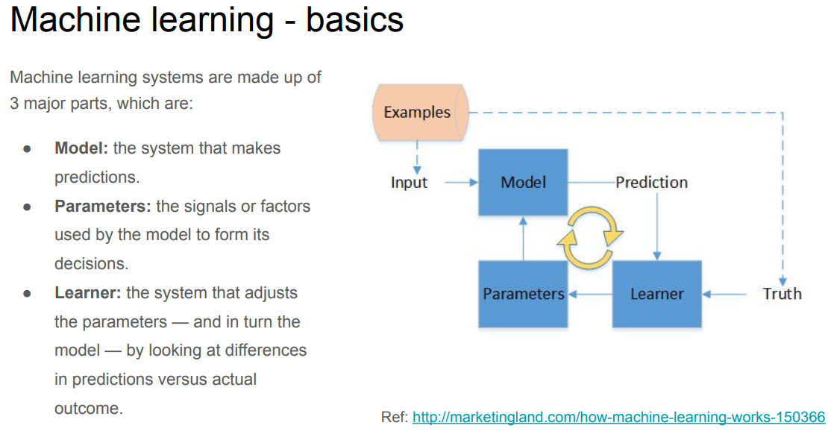

Slide 13
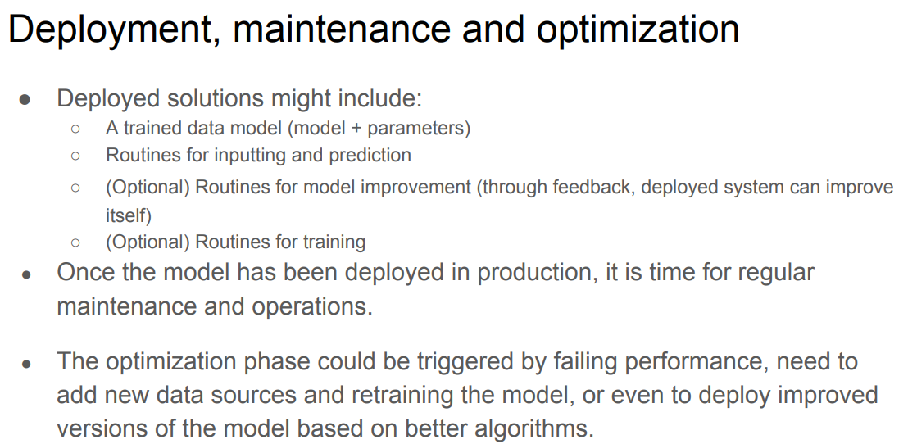

Slide 14
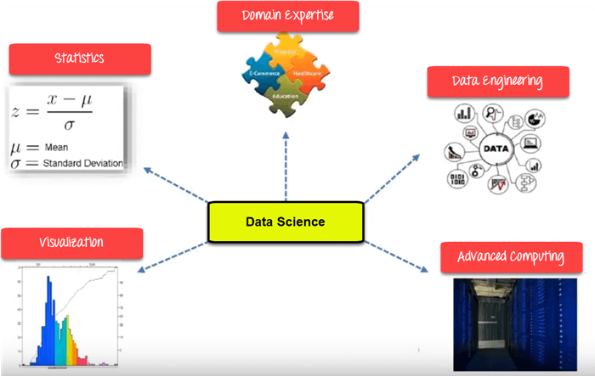

Slide 15
Basic libraries used in Data Science
NumPy: It is the basic library used for numerical computations. It is mainly used for data analysis.
Pandas: It is the must-know library which is used for data cleaning, data storage, and time series.
SciPy: It is another python library which is used to solve differential equations and linear algebra.
Matplotlib: It is the data visualization library used to analyze correlation, determine outliers using scatter plot, and to visualize data distribution.
TensorFlow: It is used for high-performance computations that reduce error by 50%. It is used for speech, image detection, time series, and video detection.
Scikit-Learn: It is used to implement supervised and unsupervised machine learning models.
Keras: It runs easily on CPU and GPU, and supports the neural networks.
Seaborn: It is another data visualization library used for multi-plot grids, histograms, scatterplots, bar charts, etc.

Slide 16
BigData and its characteristics
Businesses, governmental institutions, HCPs (Health Care Providers), and financial as well as academic institutions, are all leveraging the power of Big Data to enhance business prospects along with improved customer experience.
IBM maintains that businesses around the world generate nearly 2.5 quintillion bytes of data daily! Almost 90% of the global data has been produced in the last 2 years alone.
Big Data has penetrated almost every industry today and is a dominant driving force behind the success of enterprises and organizations across the globe.

Slide 17
What is Big Data?
“Big data” is high-volume, velocity, and variety information assets that demand cost-effective, innovative forms of information processing for enhanced insight and decision making.”

Slide 18
Types of Big Data
Structured: Data that can be processed, stored, and retrieved in a fixed format. It refers to highly organized information that can be readily and seamlessly stored and accessed from a database by simple search engine algorithms.
Unstructured: Data that lacks any specific form or structure whatsoever. This makes it very difficult and time-consuming to process and analyze unstructured data. Email is an example of unstructured data.
Semi-structured: Data containing both the formats mentioned above, that is, structured and unstructured data. To be precise, it refers to the data that although has not been classified under a particular repository (database), yet contains vital information or tags that segregate individual elements within the data.

Slide 19
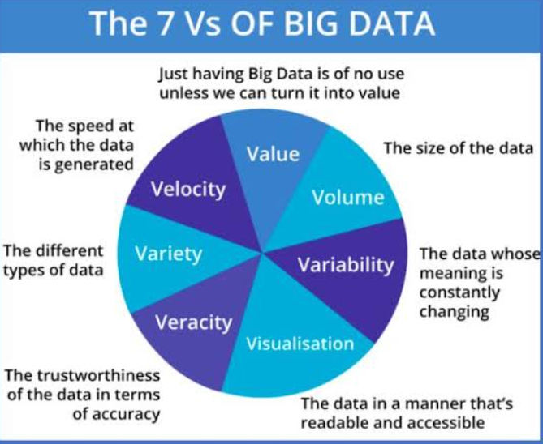
Characteristics of Big Data- 7 V’s

Slide 20
Advantages of Big Data
Big Data analytics tools can predict outcomes accurately, thereby, allowing businesses and organizations to make better decisions, while simultaneously optimizing their operational efficiencies and reducing risks.
Social media platforms using Big Data analytics tools, businesses around the world are streamlining their digital marketing strategies to enhance the overall consumer experience. Big Data provides insights into the customer pain points and allows companies to improve upon their products and services.
Big Data analytics tools to understand how well their products/services are doing in the market and how the customers are responding to them. Thus, the can understand better where to invest their time and money.
Big Data insights allow you to learn customer behavior to understand the customer trends and provide a highly ‘personalized’ experience to them.

Slide 21
Web Scraping
Web Scraping is a technique to fetch data and information from websites
Everything you see on the web page can be scraped
Web Scraping is one the Technique for collecting data.
Definition:
Web scraping, also called web harvesting, is the process of constructing an agent which can extract, parse, download and organize useful information from the web automatically.

Slide 22
Uses of Web Scraping
Web scrapers can do anything like ordering online food, scanning online shopping website for you and buying ticket of a match the moment they are available etc.
E-commerce Websites: Web scrapers can collect the data specially related to the price of a specific product from various e-commerce websites for their comparison.
Content Aggregators: Web scraping is used widely by content aggregators like news aggregators and job aggregators for providing updated data to their users.
Marketing and Sales Campaigns: Web scrapers can be used to get the data like emails, phone number etc. for sales and marketing campaigns.
Data for Machine Learning Projects: Retrieval of data for machine learning projects depends upon web scraping.

Slide 23
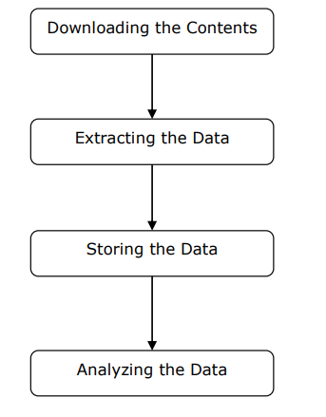
Working of Web scraping
Step 1: Downloading Contents from Web Pages In this step, a web scraper will download the requested contents from multiple web pages.
Step 2: Extracting Data The data on websites is HTML and mostly unstructured. Hence, in this step, web scraper will parse and extract structured data from the downloaded contents.
Step 3: Storing the Data Here, a web scraper will store and save the extracted data in any of the format like CSV, JSON or in database.
Step 4: Analyzing the Data After all these steps are successfully done, the web scraper will analyze the data thus obtained.

Slide 24
Python Modules for Web Scraping
Requests
Urllib3
Selenium
Scrapy

Slide 25
Web Scraping Implementation
from urllib.request import urlopen
from bs4 import BeautifulSoup
url = "http://www.hubertiming.com/results/2017GPTR10K"
html = urlopen(url)
soup = BeautifulSoup(html, 'lxml')
type(soup)
title = soup.title
print(title)

Slide 26
Structure of a Data Analysis Report
A data analysis report is somewhat different from other types of professional writing that you may have done or seen, or will learn about in the future.
The overall structure of a data analysis report is simple:
1. Introduction
2. Body
3. Conclusion(s)/Discussion
4. Appendix/Appendices

Slide 27
Outline of Report Writting
Introduction:
Good features for the Introduction include:
• Summary of the study and data, as well as any relevant substantive context, background, or framing issues.
• The “big questions” answered by your data analyses, and summaries of your conclusions about these questions.
• Brief outline of remainder of paper.
The above is a pretty good order to present this material in as well

Slide 28
Body: The body can be organized in several ways.
Divide the body up into several sections at the same level as the Introduction, with names like:
– Data
– Methods
– Analysis
– Results
This format is very familiar to those who have written psych research papers.
It often works well for a data analysis paper as well, though one problem with it is that the Methods section often sounds like a bit of a stretch: In a psych research paper the Methods section describes what you did to get your data.
In a data analysis paper, you should describe the analyses that you performed.

Slide 29
Question-oriented:
In this format there is a single Body section, usually called “Analysis”, and then there is a subsection for each question raised in the introduction, usually taken in the same order as in the introduction.
Within each subsection, statistical method, analyses, and conclusion would be described .
It is useful to provide one or two well-chosen tables or graphs per question in the body of the report, for two reasons:
First, graphical and tabular displays can convey your points more efficiently than words; and
Second, your “skimming” audiences will be more likely to have their eye caught by an interesting graph or table than by running text.

Slide 30
Conclusion(s)/Discussion: The conclusion should reprise the questions and conclusions of the introduction, perhaps augmented by some additional observations or details gleaned from the analysis section. New questions, future work, etc., can also be raised here.
Appendix/Appendices. One or more appendices are the place to out details and ancillary materials.
These might include such items as
• Technical descriptions of (unusual) statistical procedures
• Detailed tables or computer output
• Figures that were not central to the arguments presented in the body of the report
• Computer code used to obtain results.

